Slide 1
Symbian OS
-vaishali upadhyay
121059

Slide 2
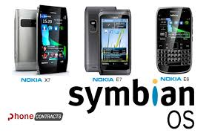
What is Symbian operating system?
Symbian Operating System is a mobile operating system with high level of integration to provide "SMARTNESS" to the "DUMB" phones for the sake of competition.
[10]

Slide 3
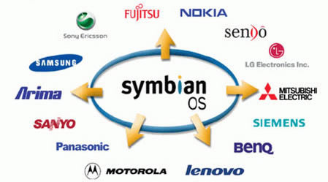
Brief history
Initially Symbian OS was started as OPEN SOURCE so that it could be modified and used by not one but many.
Sooner the main supporter of Symbian Os which was NOKIA made it proprietary so that it could lessen its competitors and made sure that it was the only one who used it.
But sooner with the advent of android, Nokia too understood it had to move ahead of SYMBIAN if it wanted to exist in the mobile world.
[9]

Slide 4
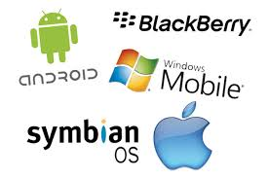
Current technology
[6]
Today, most of us present here would be having a mobile phone and not only that but mostly an ANDROID SMARTPHONE, some would be having IOS(APPLE) phone and few but not less would be having WINDOWS based SMARTPHONES. Almost nobody would be having a phone whose operating system is SYMBIAN.
Nobody would like to use a phone which is not able to be smart when the whole world is using nothing but smartphones. Hence there is not much rather almost zero percent usage of Symbian OS based mobile phones.

Slide 5
ADVANTAGES
Better security:
current os – needs a separate antivirus to be installed.
Symbian OS comes with a certificate management.
Multitasking:
Even during its rein, the SYMBIAN OS provided multi-tasking that was proper.
Operation: Every Symbian phone consists of a home key, which can be used to multi-task with ease, which has now been done for all the smartphones. but it was one in its kind. moreover it also gave the control of what stays open and what gets closed. so you have multitasking control.
At that time many os provided multitasking by either an external application or suspending some applications.
Hence was the simplest multitasking operation.

Slide 6
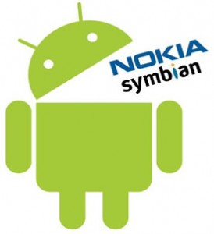
Why Symbian Doomed?
Complexity:
Symbian's code had difficult and unfriendly structure and hence it took a lot of time to develop a phone using such an OS.
BGR quotes a Nokia spokesperson complaining that a typical Symbian handset required 22 months of development time, compared to less than a year with Windows Phone. today when the phone market is developed and sold in weeks and every month we see 10 new mobile phones , such slow development would yield only losses.[4]
Not an open source anymore :
As it became an liscenced version, its licensed source code was available to only member companies.
In comparison, if it had been an open source, the code would have been free of restrictions, which would have helped spur its use among manufacturers, carriers, and the developer community
[7]

Slide 7
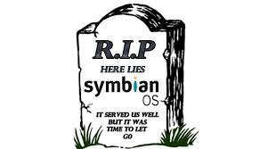
Advancement in Symbian
After all this discussion today, we know that the SYMBIAN as operating system has been outdated now and almost seems to be dead with NOKIA also taking its hands out of it.
But as a part of after sale service Nokia has to see to it that its handsets have been given maintenance for a certain period of time. For this purpose, it has been handed to ACCENTURE by NOKIA till 2016[1].
But if we see development of Symbian OS then it is zero since no mobile system is interested for taking up Symbian.
[8]

Slide 8
References
http://licensing.symbian.org/
http://techcrunch.com/2013/06/13/rip-symbian/
http://discussions.nokia.com/t5/Software-Updates/Symbian-vs-Android/td-p/1111407
http://www.pcworld.com/article/2042071/the-end-of-symbian-nokia-ships-last-handset-with-the-mobile-os.html
http://www.allaboutsymbian.com/
http://pixshark.com/symbian-os-logo-png.htm
http://www.techbusy.org/android-vs-symbian-operating-system/
http://dhavalthakur.com/2013/01/29/symbian-software-officially-dead-confirms-nokia/
http://imgbuddy.com/symbian-os-logo-png.asp
http://wandroide.ru/symbian-os-pervaya-mobilnaya-os/

